Slide 1
IMAGE Compression
Image compression is an implementation of the data compression which encodes actual image with some bits.
The purpose of the image compression is to decrease the redundancy and irrelevance of image data to be capable to record or send data in an effective form.
Hence the image compression decreases the time of transmit in the network and raises the transmission speed.

Slide 2
LOSELESS IMAGE COMPRESSION
Lossless compression minimizes distortion as much as possible, preserving image clarity. It does this by building an index of all the pixels and grouping same-colored pixels together. Some examples:
PNG
TIFF
WebP
BPG, etc

Slide 3
LOSSY IMAGE COMPRESSION
As the name implies, lossy compression makes an image lose some of its content. But lossy doesn’t imply that you’re eliminating pixels.
There are two algorithms commonly used to compress images this way: transform encoding and chroma subsampling. The former is more common in images and the latter in video. Some examples:
JPEG
JPEG 2000
WebP
Wavelet Compression, etc

Slide 4
(2.0)IMAGE TRANSFORMATION
An image transform can be applied to an image to convert it from one domain to another. Viewing an image in domains such as frequency or Hough space enables the identification of features that may not be as easily detected in the spatial domain. Common image transforms include:
Discrete Fourier Transform
Wavelet Transform
Discrete Cosine Transform
Hadamard Transform
Slant Transform

Slide 5
(3.0)FOURIER ANALYSIS

Slide 6
(3.1)WHAT IS FOURIER TRANSFORM OR ANALYSIS?
Every signal has a spectrum and is uniquely determined by its spectrum. There are a few domains in which spectrum of any signal is studied.
They are: Spatial, Frequency, Time and Temporal.
‘Transformation’ is conversion of one of these domains to another.
Fourier transform in a method of decomposition of function of time into its constituent frequencies. i.e time domain to frequency domain.

Slide 7
Where to start?
Fourier analysis was originally concerned with representing an analysing periodic phenomena, via the Fourier Series, and later with extending those insights to non-periodic phenomena, via the Fourier Transform.
In fact, one way of getting from Fourier series to Fourier Transform is to consider non-periodic phenomena as a limiting case of periodic phenomena as period tends to infinity.
So, we will start from Fourier series!

Slide 8
(3.2)PERIODIC PHENOMENA
To begin studying Fourier series is to begin with Periodic Phenomena, those functions which exhibit a regularly repeating pattern.
We can think of periodic phenomena as periodic in time and periodic in space.
In the case of time, the phenomenon comes to you. E.g. you stand at a fixed point in the ocean and the waves wash over you with a regular, recurring pattern of crests and troughs.
In case of Space, you come to the phenomena. You take a picture and you observe repeating patterns.

Slide 9
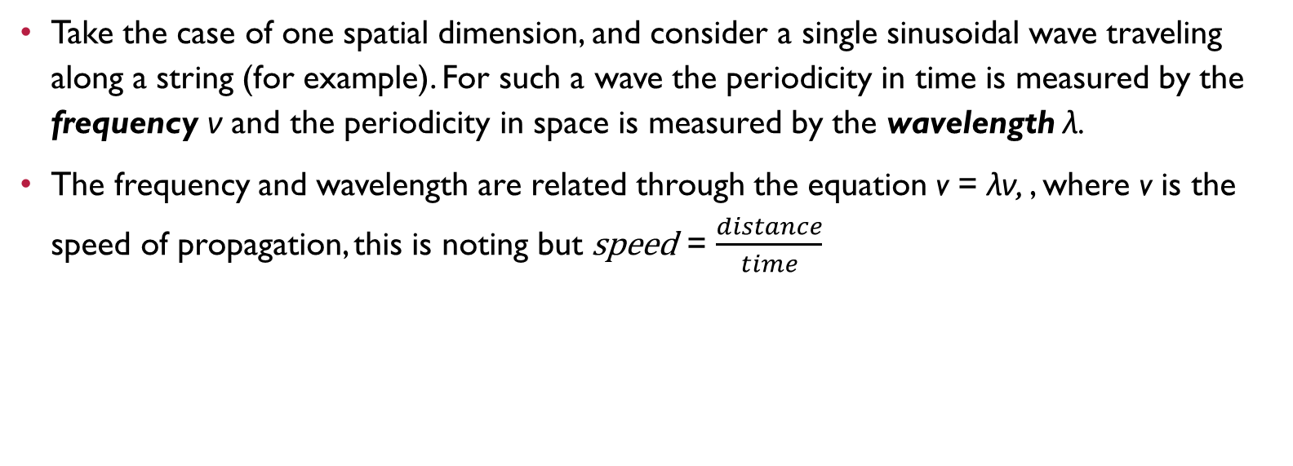
Take the case of one spatial dimension, and consider a single sinusoidal wave traveling along a string (for example). For such a wave the periodicity in time is measured by the frequency ν and the periodicity in space is measured by the wavelength λ.
The frequency and wavelength are related through the equation v = λν, , where v is the speed of propagation, this is noting but speed = $\frac{distance}{time}$

Slide 10
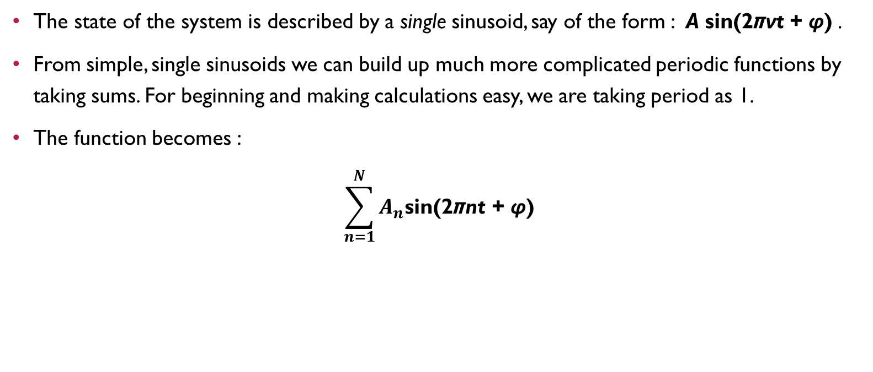
(3.3)It all adds up
The state of the system is described by a single sinusoid, say of the form : A sin(2πνt + φ) .
From simple, single sinusoids we can build up much more complicated periodic functions by taking sums. For beginning and making calculations easy, we are taking period as 1.
The function becomes :
$$\sum_{n=1}^{N}{A_{n}\text{sin}\text{(2}\text{π}\text{n}\text{t} \text{+ }\text{φ}\text{)}}$$

Slide 11
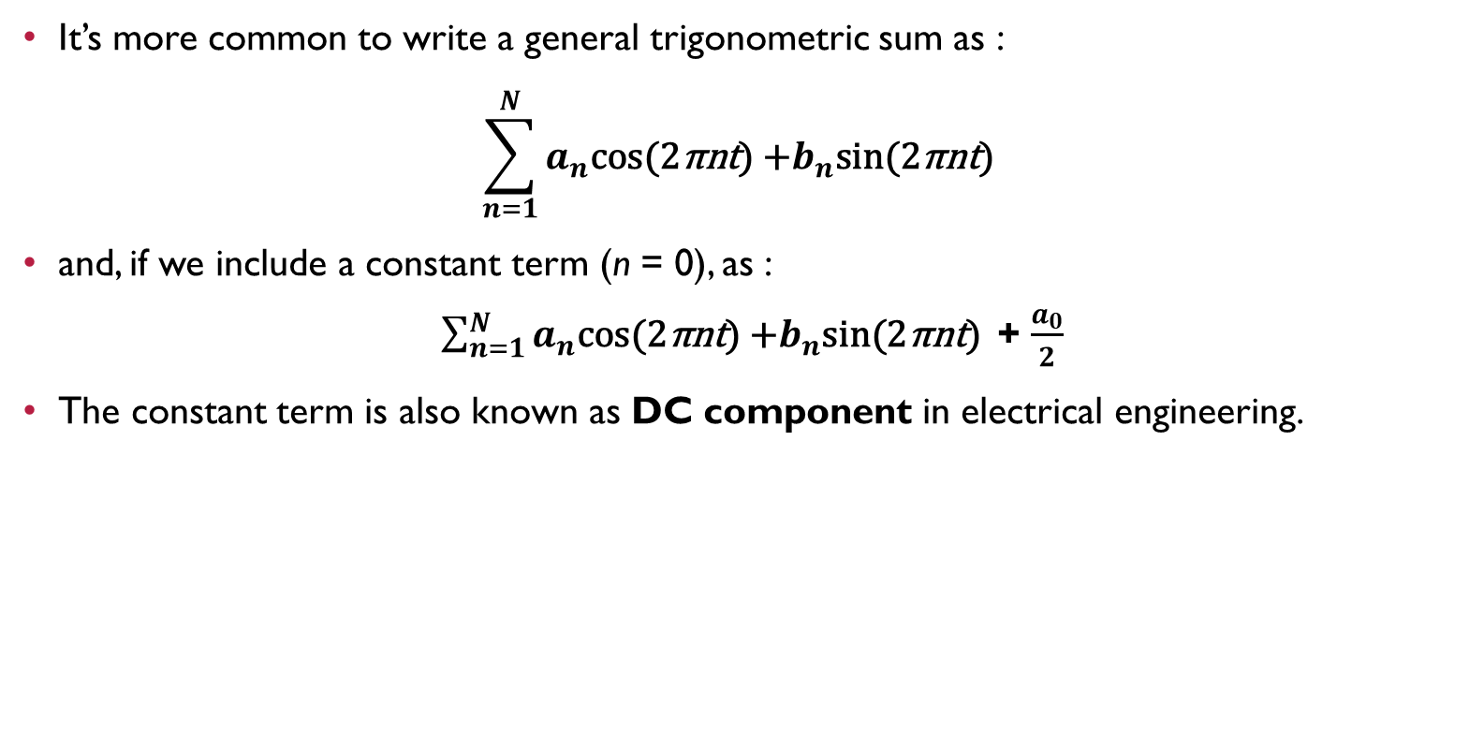
It’s more common to write a general trigonometric sum as :
$$\sum_{n=1}^{N}{a_{n}\text{cos}\text{(2}\text{π}\text{nt}\text{)}\text{ +}b_{n}\text{sin}\text{(2}\text{π}\text{nt}\text{) }}$$
and, if we include a constant term (n = 0), as :
$\sum_{n=1}^{N}{a_{n}\text{cos}\text{(2}\text{π}\text{nt}\text{)}\text{ +}b_{n}\text{sin}\text{(2}\text{π}\text{nt}\text{) }}$+ $\frac{a_{0}}{2}$
The constant term is also known as DC component in electrical engineering.

Slide 12
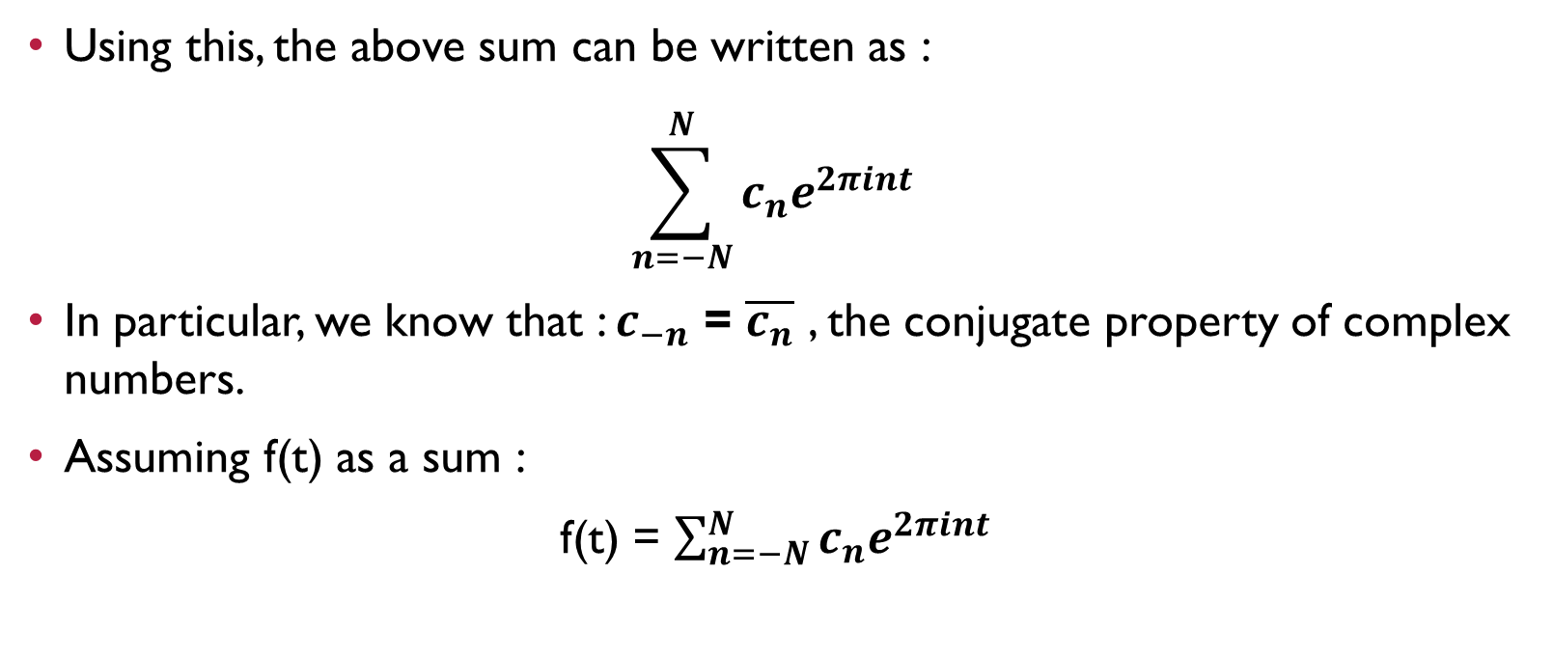
Using this, the above sum can be written as :
$$\sum_{n=−N}^{N}{c_{n}e^{2πint}}$$
In particular, we know that : $c_{−n}$ = $\overline{c_{n}}$ , the conjugate property of complex numbers.
Assuming f(t) as a sum :
f(t) = $\sum_{n=−N}^{N}{c_{n}e^{2πint}}$

Slide 13
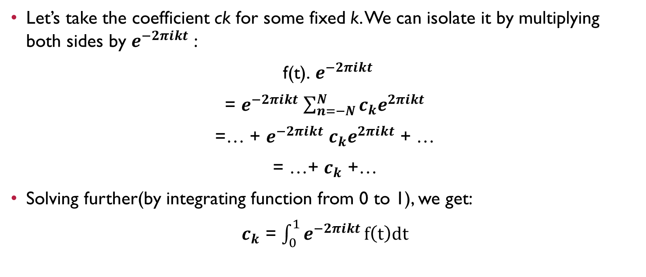
Let’s take the coefficient ck for some fixed k. We can isolate it by multiplying both sides by $e^{−2πikt}$ :
f(t). $e^{−2πikt}$
= $e^{−2πikt}$ $\sum_{n=−N}^{N}{c_{k}e^{2πikt}}$
=… + $e^{−2πikt}$ $c_{k}e^{2πikt}$ + …
= …+ $c_{k}$ +…
Solving further(by integrating function from 0 to 1), we get:
$c_{k}$ = $\int_{0}^{1}{e^{−2πikt}}f\left(t\right)dt$

Slide 14
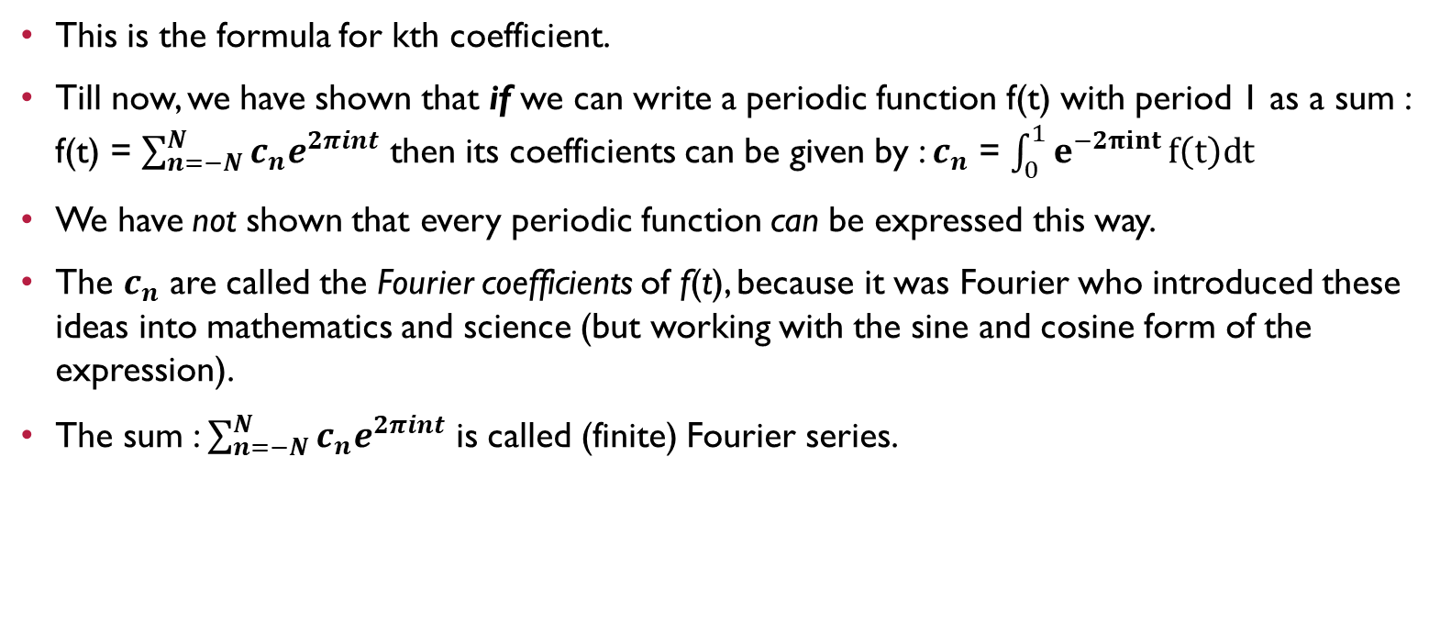
This is the formula for kth coefficient.
Till now, we have shown that if we can write a periodic function f(t) with period 1 as a sum : f(t) = $\sum_{n=−N}^{N}{c_{n}e^{2πint}}$ then its coefficients can be given by : $c_{n}$ = $\int_{0}^{1}{e^{−2πint}}f\left(t\right)dt$
We have not shown that every periodic function can be expressed this way.
The $c_{n}$ are called the Fourier coefficients of f(t), because it was Fourier who introduced these ideas into mathematics and science (but working with the sine and cosine form of the expression).
The sum : $\sum_{n=−N}^{N}{c_{n}e^{2πint}}$ is called (finite) Fourier series.

Slide 15

(3.4)CODE TO GET FOURIER COEFFICIENTS (UPTO nth harmonic) of a simple function
Code is as given in the next page.
Formula used:
$a_{n}$ = 2/T.$\int_{0}^{T}{cos⁡(}2πnt/T)x\left(t\right)dt$
$b_{n}$ = 2/T.$\int_{0}^{T}{sin⁡(}2πnt/T)x\left(t\right)dt$
X(t) = $\sum_{n=1}^{∞ }{a_{n}\text{cos}\text{(2}\text{π}\text{nt}\text{/}\text{T}\text{)}\text{ +}b_{n}\text{sin}\text{(2}\text{π}\text{nt}\text{/}\text{T}\text{) }}$+ $\frac{a_{0}}{2}$

Slide 16
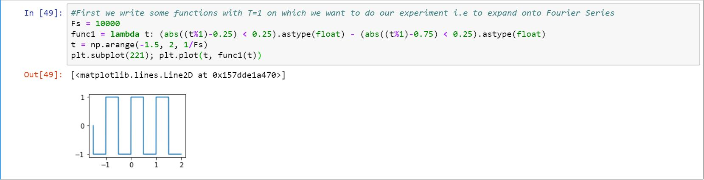

Slide 17
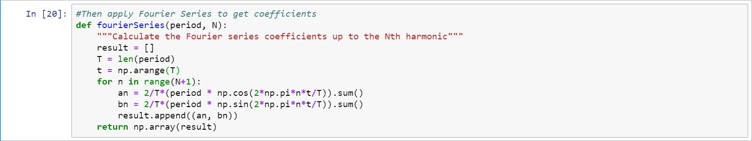

Slide 18
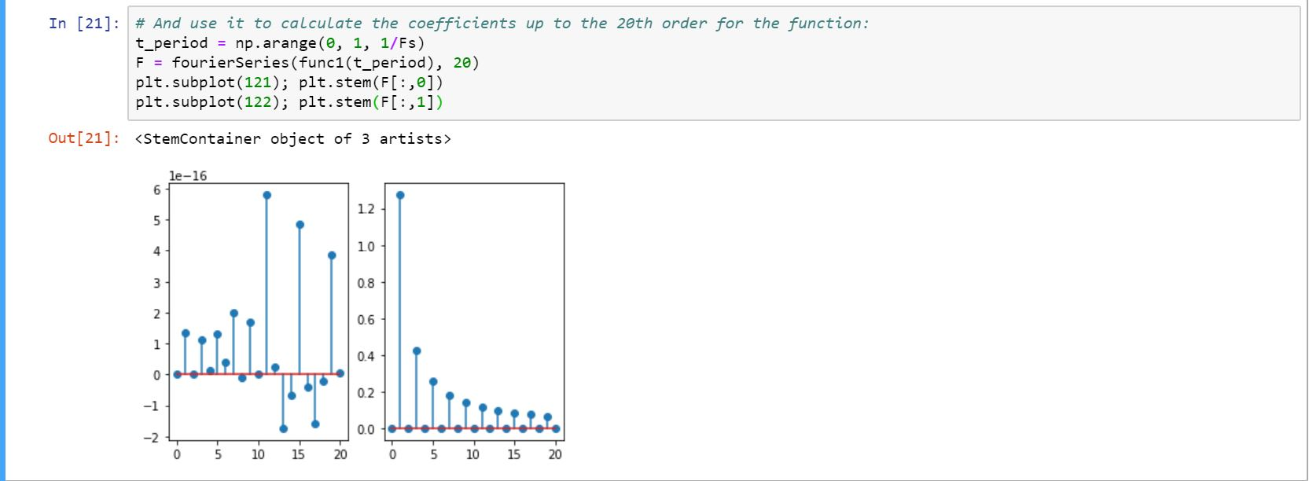

Slide 19
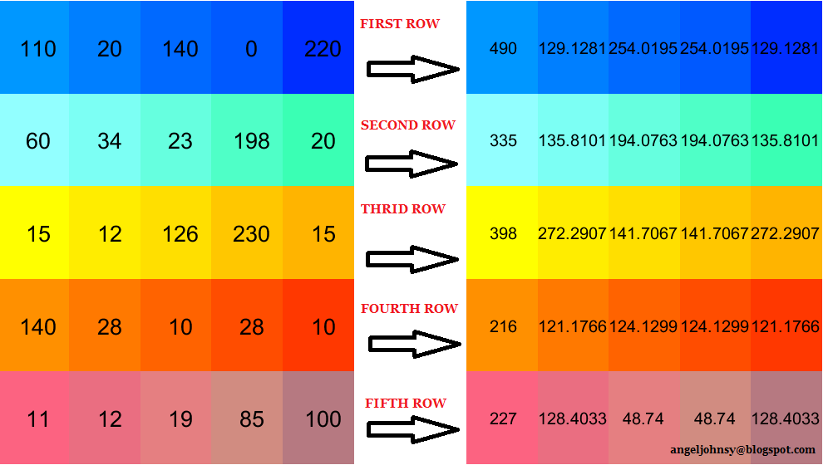
Fourier Transform can be done to a 2D image by simply taking one row at a time and thus making 1-D FT each time for every row.

Slide 20
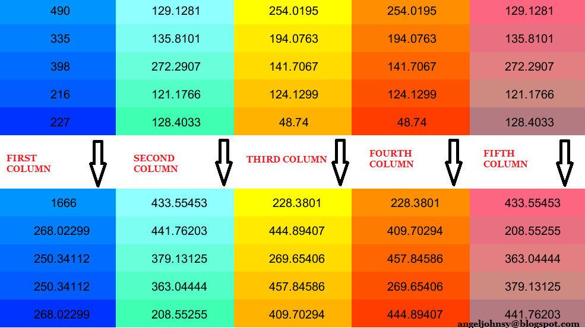
Then perform it for each column(in the altered matrix as obtained above):

Slide 21
FFT- A computationally more efficient way to calculate dft
The Discrete Fourier Transform (DFT) is a specific form of Fourier analysis to convert one function (often in the time or spatial domain) into another (frequency domain).
DFT is widely employed in signal processing and related fields to analyze frequencies contained in a sample signal, to solve partial differential equations, and to perform other operations such as convolutions.
Fast Fourier Transform (FFT) is applied to convert an image from the image (spatial) domain to the frequency domain. Applying filters to images in frequency domain is computationally faster than to do the same in the image domain.

Slide 22
I will not go into the theory of FFT but instead I will address the implementation of the algorithm in converting a 2D image to the frequency domain and back to the image domain (Inverse FFT).
Once the image is transformed into the frequency domain, filters can be applied to the image by convolutions. FFT turns the complicated convolution operations into simple multiplications. An inverse transform is then applied in the frequency domain to get the result of the convolution.

Slide 23
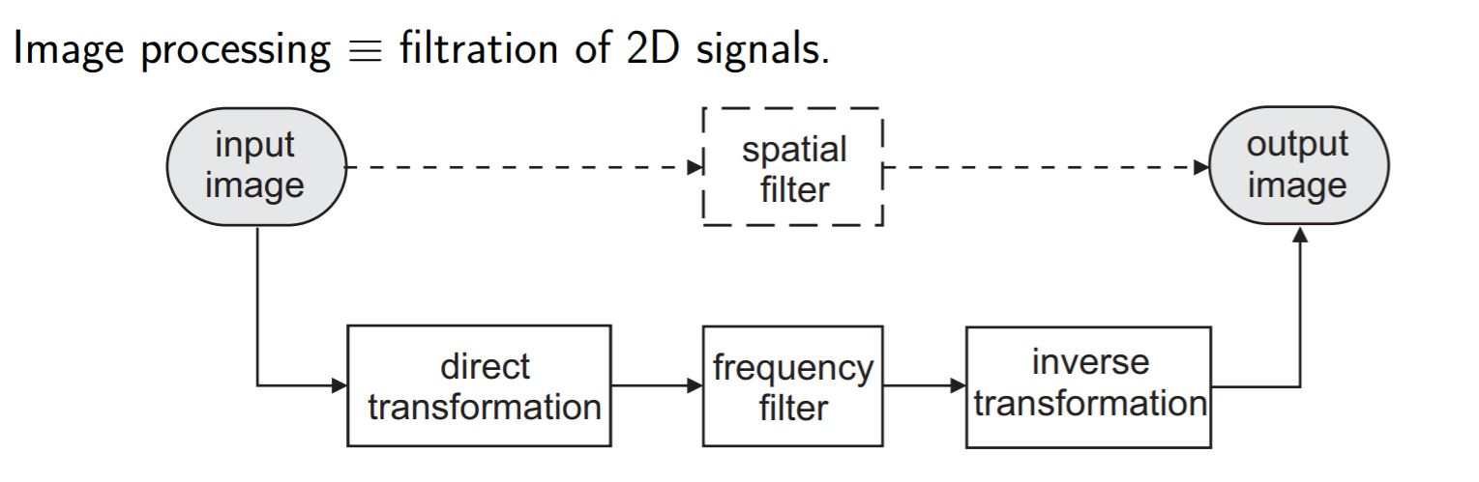

Slide 24
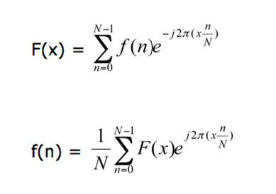
FOURIER TRANSFORM OF 1D SIGNALS

Slide 25
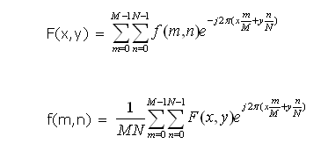
Fourier transform OF 2d signals

Slide 26
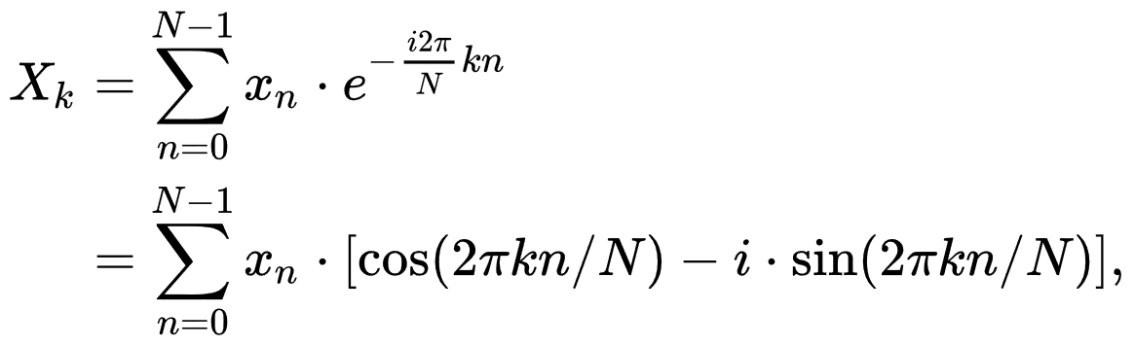


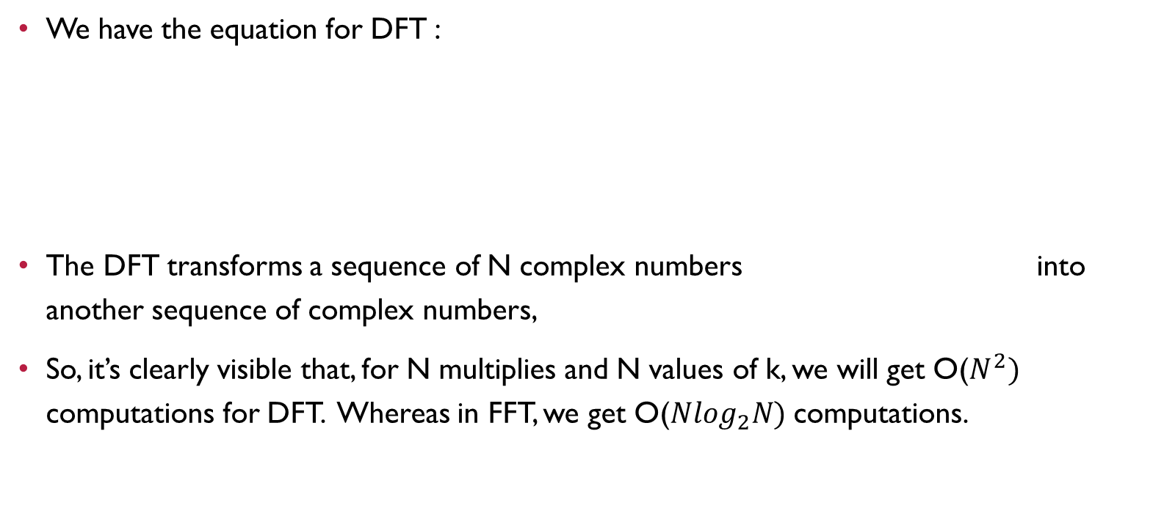
The dft
We have the equation for DFT :
The DFT transforms a sequence of N complex numbers into another sequence of complex numbers,
So, it’s clearly visible that, for N multiplies and N values of k, we will get O($N^{2})$ computations for DFT. Whereas in FFT, we get O(${Nlog}_{2}N)$ computations.

Slide 27
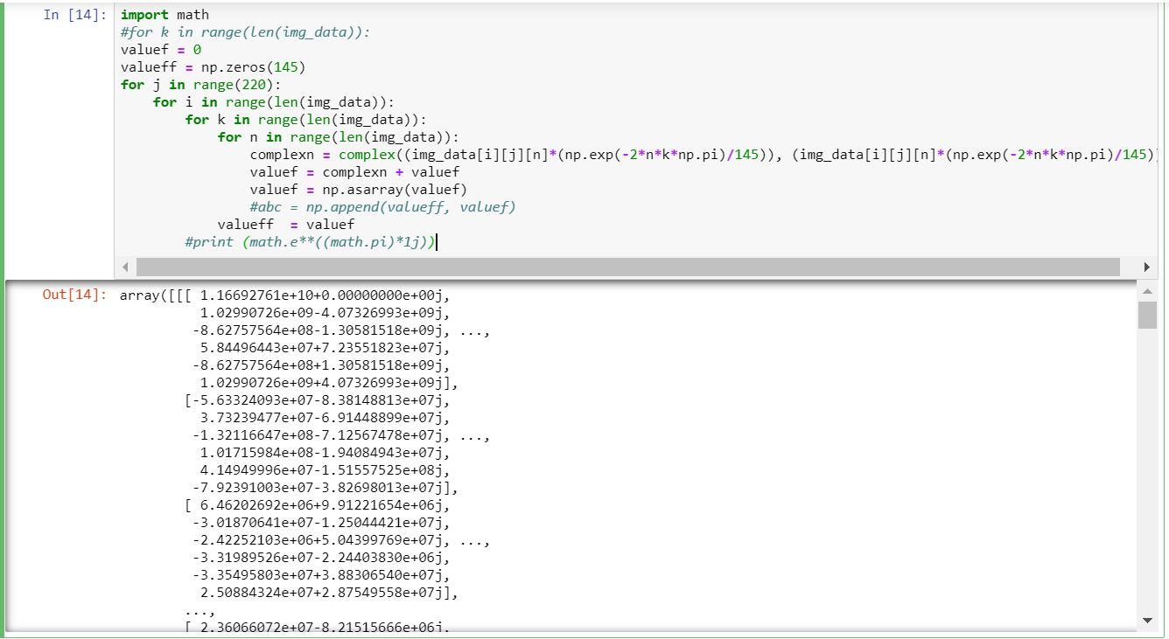
3-D Fast fourier transform on hyperspectral image (145*145*220)

Slide 28
(4.0)WAVELETS
Real world data/signals frequently exhibit slowly changing oscillations punctuated with transients.
On the other hand, images have smooth regions interrupted by edges or abrupt changes in contrast.
These abrupt changes are the most valuable part of the data.
Fourier analysis is a powerful tool for data analysis, however it does not represent abrupt changes efficiently because the FT represents the data as the sum of sinusoids, which are not localized in time or space, these sine waves oscillate forever.

Slide 29
Therefore, to accurately analyse signals and images that have abrupt changes, we need to use a new class of functions which are well localized in time and frequency which brings to the topic of wavelets.
A wavelet is a rapidly decaying wave-like oscillation that has 0 mean. Unlike sinusoids which extend to infinity, a wavelet exists for a finite duration.
Wavelets come in different shapes and sizes.

Slide 30
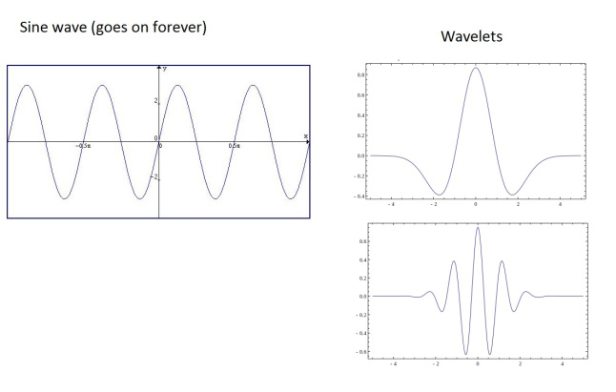

Slide 31
(4.1)WHY WAVELET TRANSFORM?
Compression application : If we can create a suitable representation of a signal, we can discard the least significant pieces of that representation and thus keep the original signal largely intact. This requires a transformation which separates the important parts of the signal from less important parts.
Edge detection : With this application it is most important to identify the areas in which the input image changes quickly. We can discard the smooth (low frequency) parts. The simplest wavelet basis, the Haar basis (to be discussed later) is suitable for this application

Slide 32
Graphics : Two prominent uses of wavelets in graphics include – Curve and Surface representations & Wavelet Radiosity. These two reflect two quite different uses of wavelets.
Numerical analysis : Wavelets are used in the solution of partial differential equations and integral equations.

Slide 33
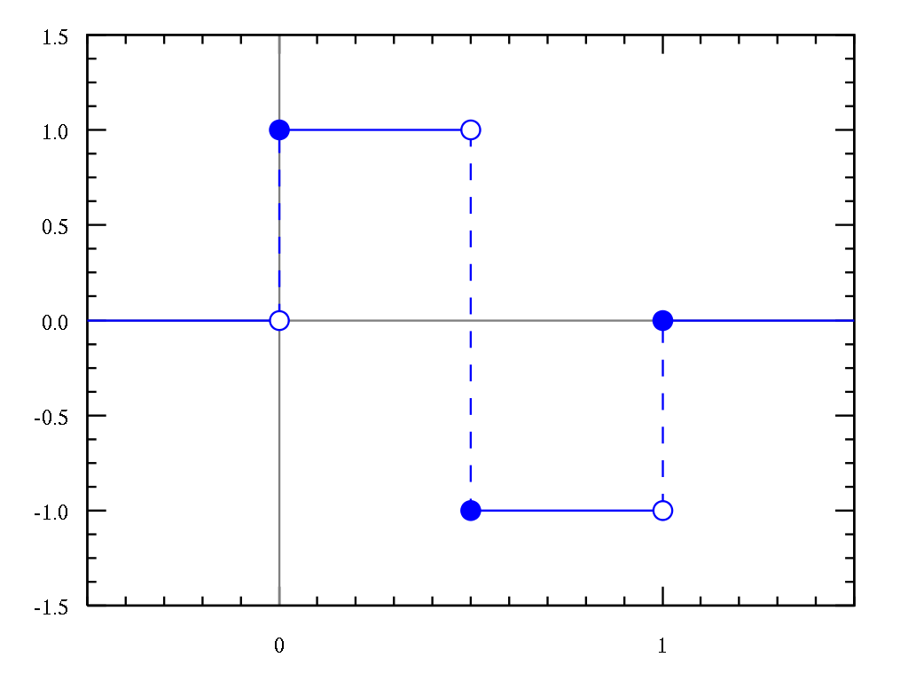
HAAR WAVELET
In mathematics, the Haar wavelet is a sequence of rescaled "square-shaped" functions which together form a wavelet family or basis. Wavelet analysis is similar to Fourier analysis in that it allows a target function over an interval to be represented in terms of an orthonormal basis.

Slide 34
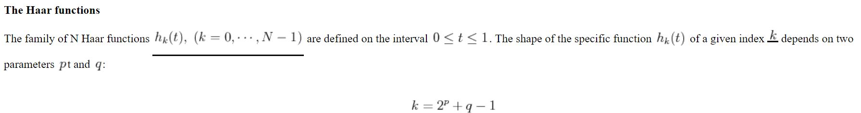
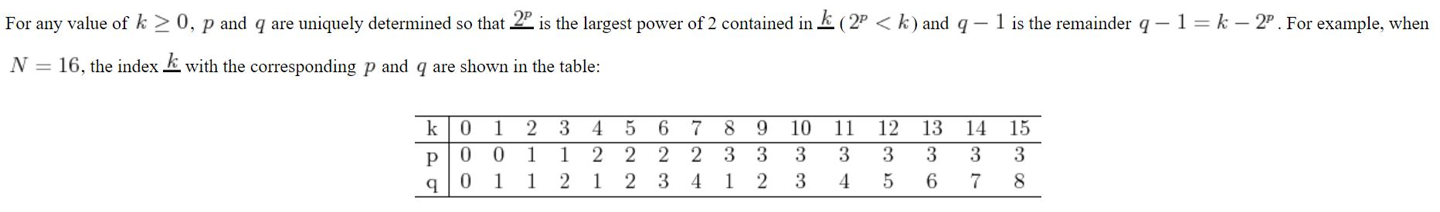
HAAR TRANSFORM

Slide 35
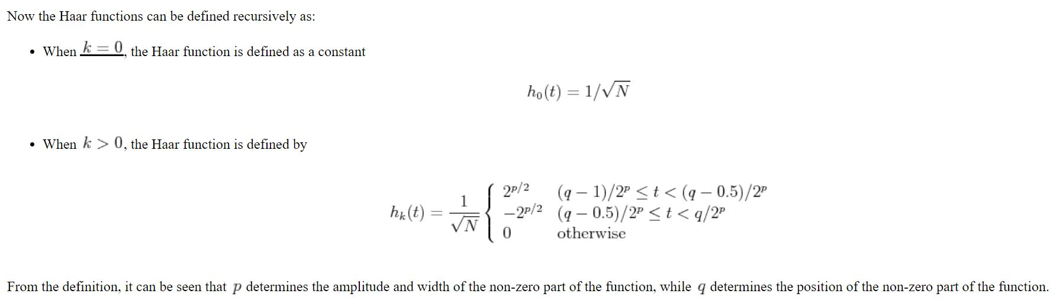

Slide 36
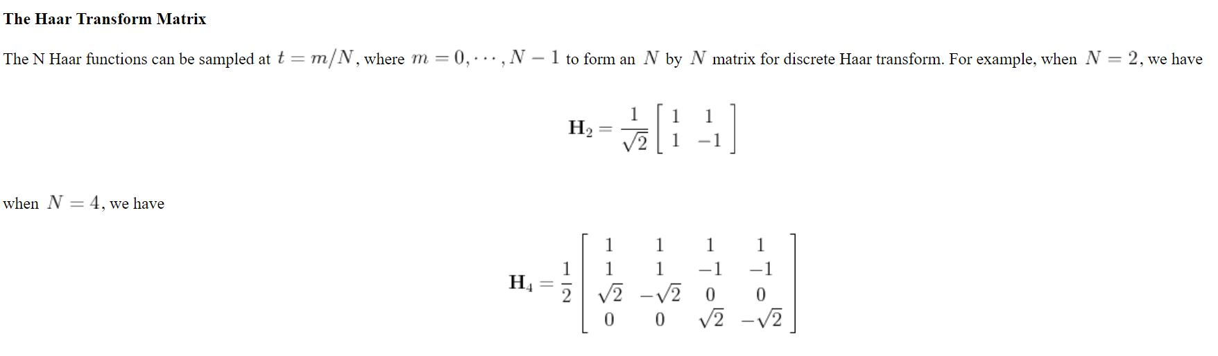

Slide 37
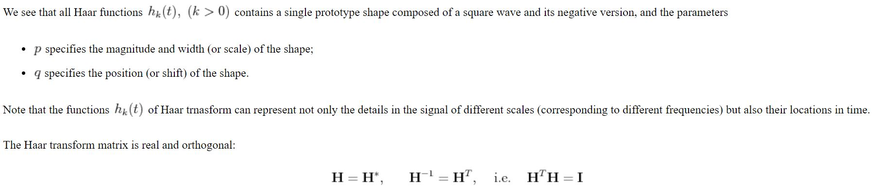

Slide 38
HAAR WAVELET transform on hyperspectral image (145*145*220)

Slide 40
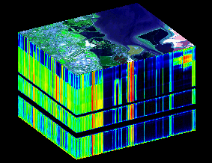
HYPERSPECTRAL IMAGING
Hyperspectral imaging, like other spectral imaging, collects and processes information from across the electromagnetic spectrum. The goal of hyperspectral imaging is to obtain the spectrum for each pixel in the image of a scene, with the purpose of finding objects, identifying materials, or detecting processes.

Slide 41
Whereas the human eye sees color of visible light in mostly three bands (long wavelengths - perceived as red, medium wavelengths - perceived as green, and short wavelengths - perceived as blue), spectral imaging divides the spectrum into many more bands.
This technique of dividing images into bands can be extended beyond the visible.
In hyperspectral imaging, the recorded spectra have fine wavelength resolution and cover a wide range of wavelengths. Hyperspectral imaging measures continuous spectral bands, as opposed to multispectral imaging which measures spaced spectral bands.

Slide 42
Hyperspectral sensors collect information as a set of 'images'. Each image represents a narrow wavelength range of the electromagnetic spectrum, also known as a spectral band.
These 'images' are combined to form a three-dimensional (x,y,λ) hyperspectral data cube for processing and analysis, where x and y represent two spatial dimensions of the scene, and λ represents the spectral dimension (comprising a range of wavelengths).

Slide 43
DISCRETE COSINE transform (DCT) on hyperspectral image (145*145*220)

